Slide 1
Gas Filling Station CRM Application
Project Documentation - Salesforce Developer Implementation

Slide 2
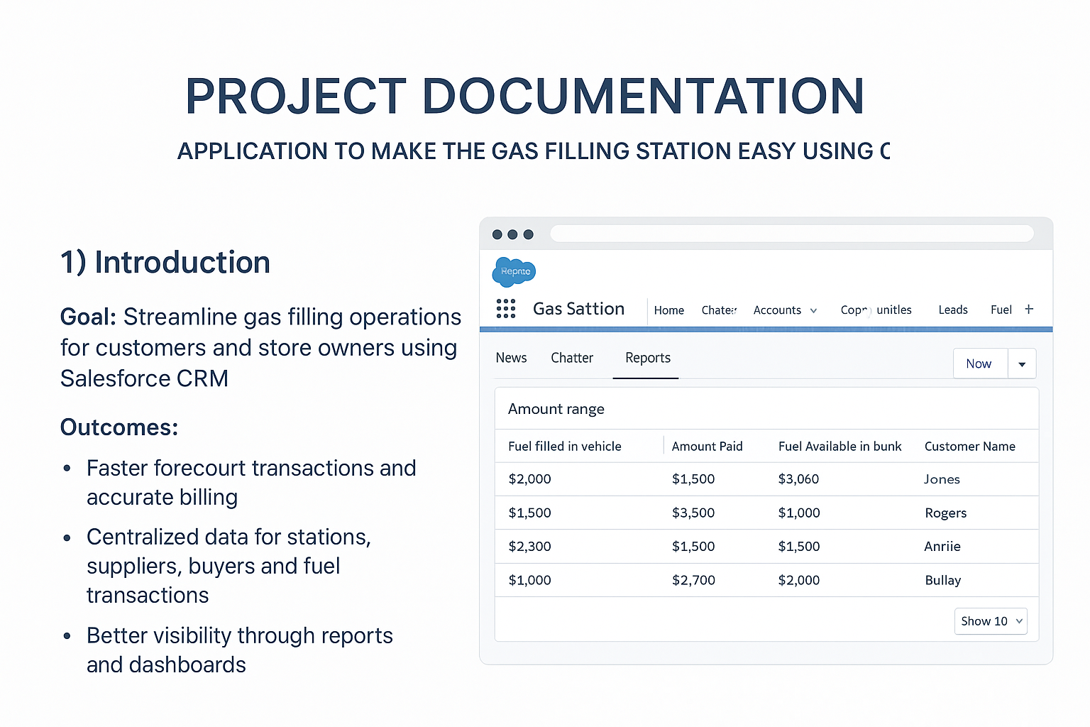
Introduction & Outcomes
Goal: Streamline gas filling operations with Salesforce CRM
Faster transactions and accurate billing
Centralized data for stations, suppliers, buyers, fuel
Role-based security, auditability, and automation

Slide 3
Salesforce Overview
Cloud-based CRM platform
Create custom objects, apps, automation (Flows/Apex)
Reports & Dashboards for better analysis
No server management required

Slide 4
Core Data Model
Objects: Supplier, Gas Station, Buyer, Fuel details
Relationships:
Fuel details ↔ Supplier (Master-Detail)
Fuel details ↔ Gas Station (Master-Detail)
Buyer ↔ Gas Station (Master-Detail)

Slide 5
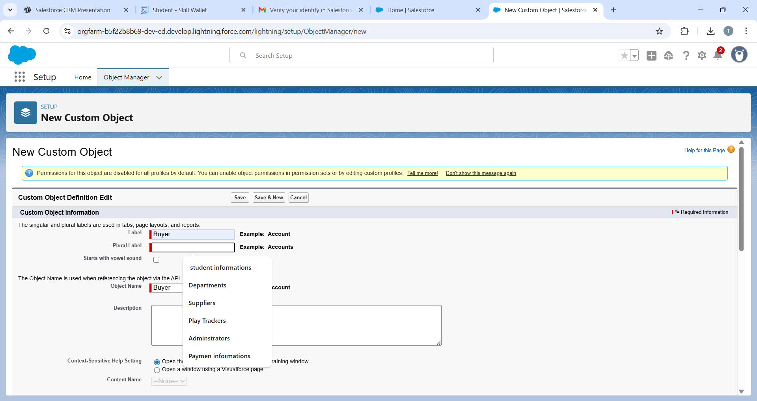
Custom Objects & Tabs
Supplier, Gas Station, Buyer, Fuel details
. Enable: Allow Reports, Search, Field History
Create navigation tabs for each object

Slide 6
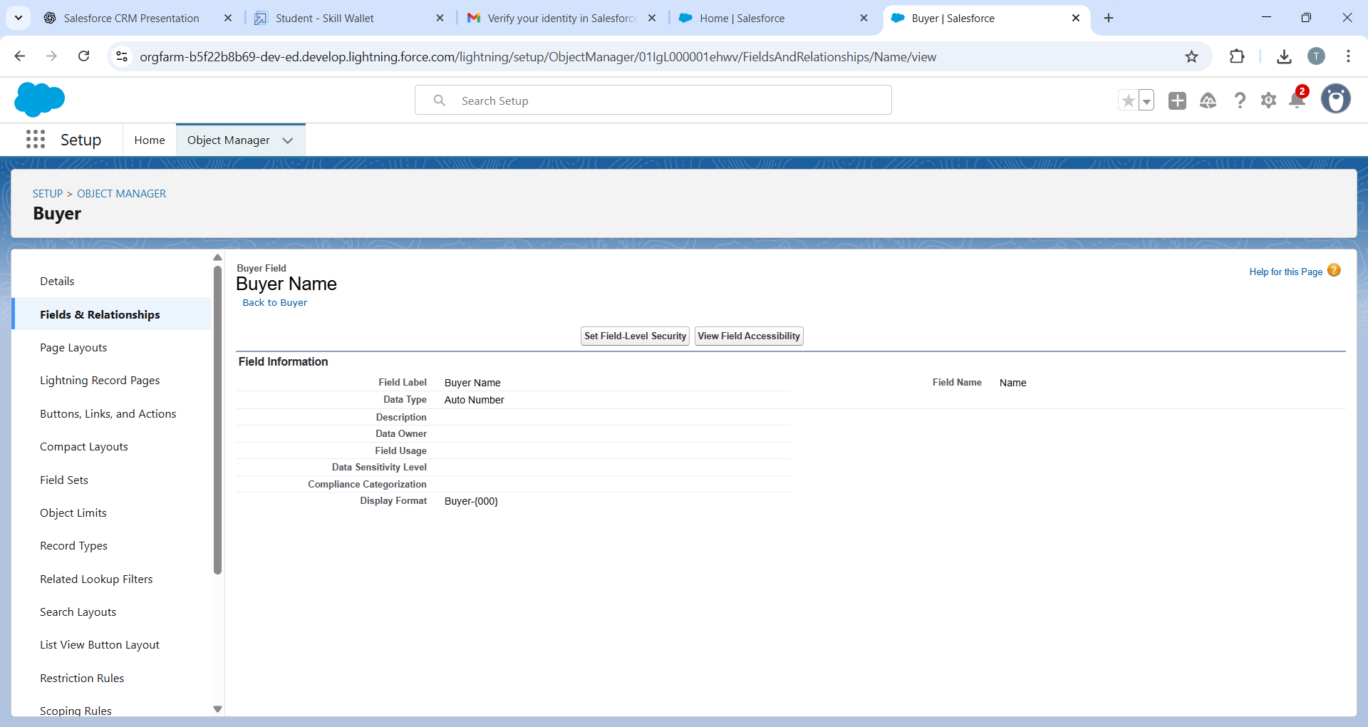
Key Fields & Relationships
Fuel details: Supplier Name, Gas Station, Fuel supplied
Supplier: Sum of Fuel supplied (Roll-up)
Gas Station: Fuel Price/litre, Fuel used, Fuel available
Buyer: Name, Contact, Vehicle, Fuel filled, Amount Paid

Slide 7
Lightning App & Layouts
App: GAS STATION (Navigation bundle)
Navigation: Supplier, Gas Station, Buyer, Fuel details
Buyer Layout: Personal details, Vehicle info, Fuel details

Slide 8
Security Setup
Profiles: Manager, Sales Executive, Sales Person
Roles: Manager > Sales Executive > Sales Person
OWD: Gas Station & Supplier = Public Read-Only
Permission Set P1: Fuel details (Read, Create)

Slide 9
Reports & Dashboards
Report Folder: Fuel Estimation
Report: Amount range (Fuel vs. Amount Paid)
Dashboard Folder: Amount estimation dashboard
Dashboard: Visualize Fuel & Payments

Slide 10
Automation & Triggers
Flow: Send email notification to Buyer
Apex Trigger: Prevent delete if Fuel > 500
Apex Trigger: Validate Fuel Price/litre > 50

Slide 11
Testing & Acceptance
Seed Data: 3 Suppliers, 2 Gas Stations, 10 Buyers, 10+ Fuel records
Verify Roll-ups & Formulas
Check Trigger & Validation Rules
Acceptance: Reports, Dashboards, Emails, Security working

